Slide 1

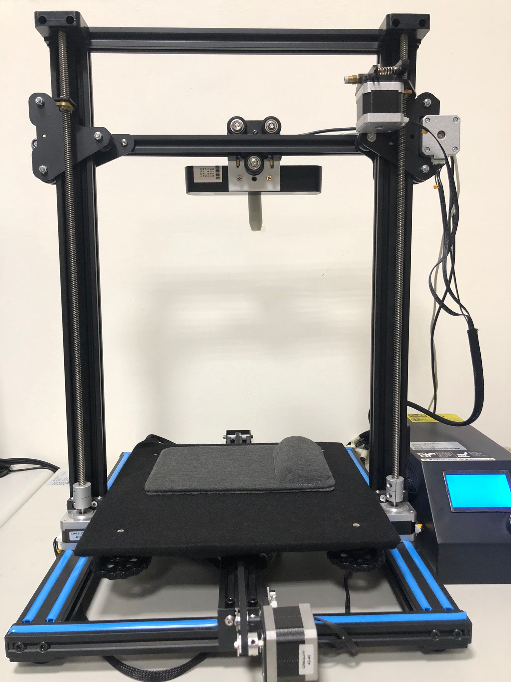
Automated Pulse Sensing Tool
Tyler Edwardo Eck - 410821337
NDHU Undergraduate Project
Advisor: 顏士淨 (Shi-Jim Yen)

Slide 2
Agenda
Introduction
Motive
Implementation
Program Execution
Research Results
Conclusion

Slide 3
Introduction

Slide 4
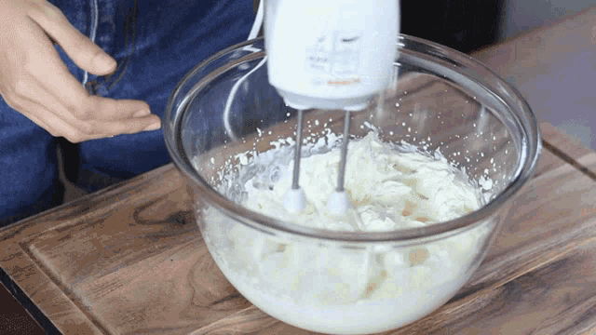
Automation
Automation technology is slowly creeping into our lives

Slide 5
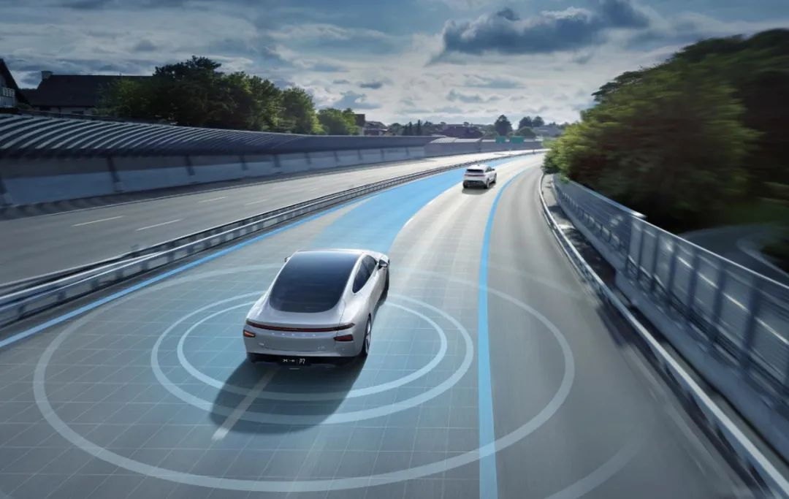
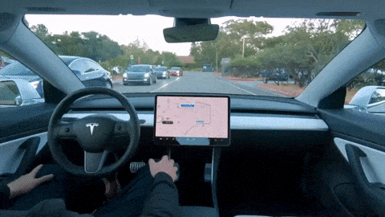
Tesla: Autonomous Vehicle

Slide 6
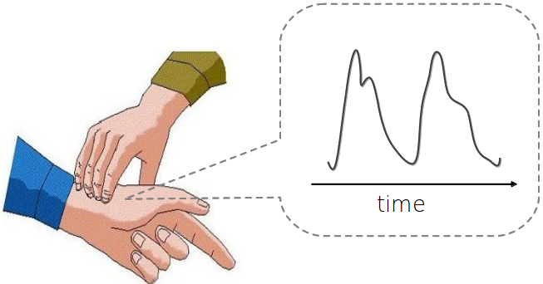
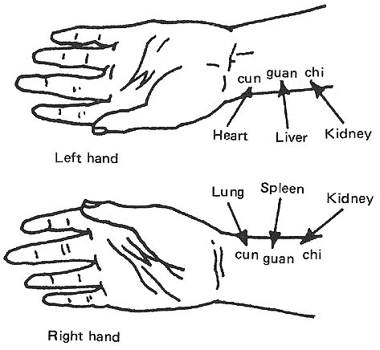
Traditional Chinese Medicine: Pulse Diagnosis
Apply automation to a medical procedure
One of the four main assessments in TCM consultation
Cun, Guan, Chi – 3 pulse points on the wrist
Still popular to this day

Slide 7
Objective/Goal:
Automated Pulse Sensing Tool
+
TCM Pulse Diagnosis
=
Automation
To design and implement an automated pulse sensing tool that will allow for users to measure their pulse with ease

Slide 8
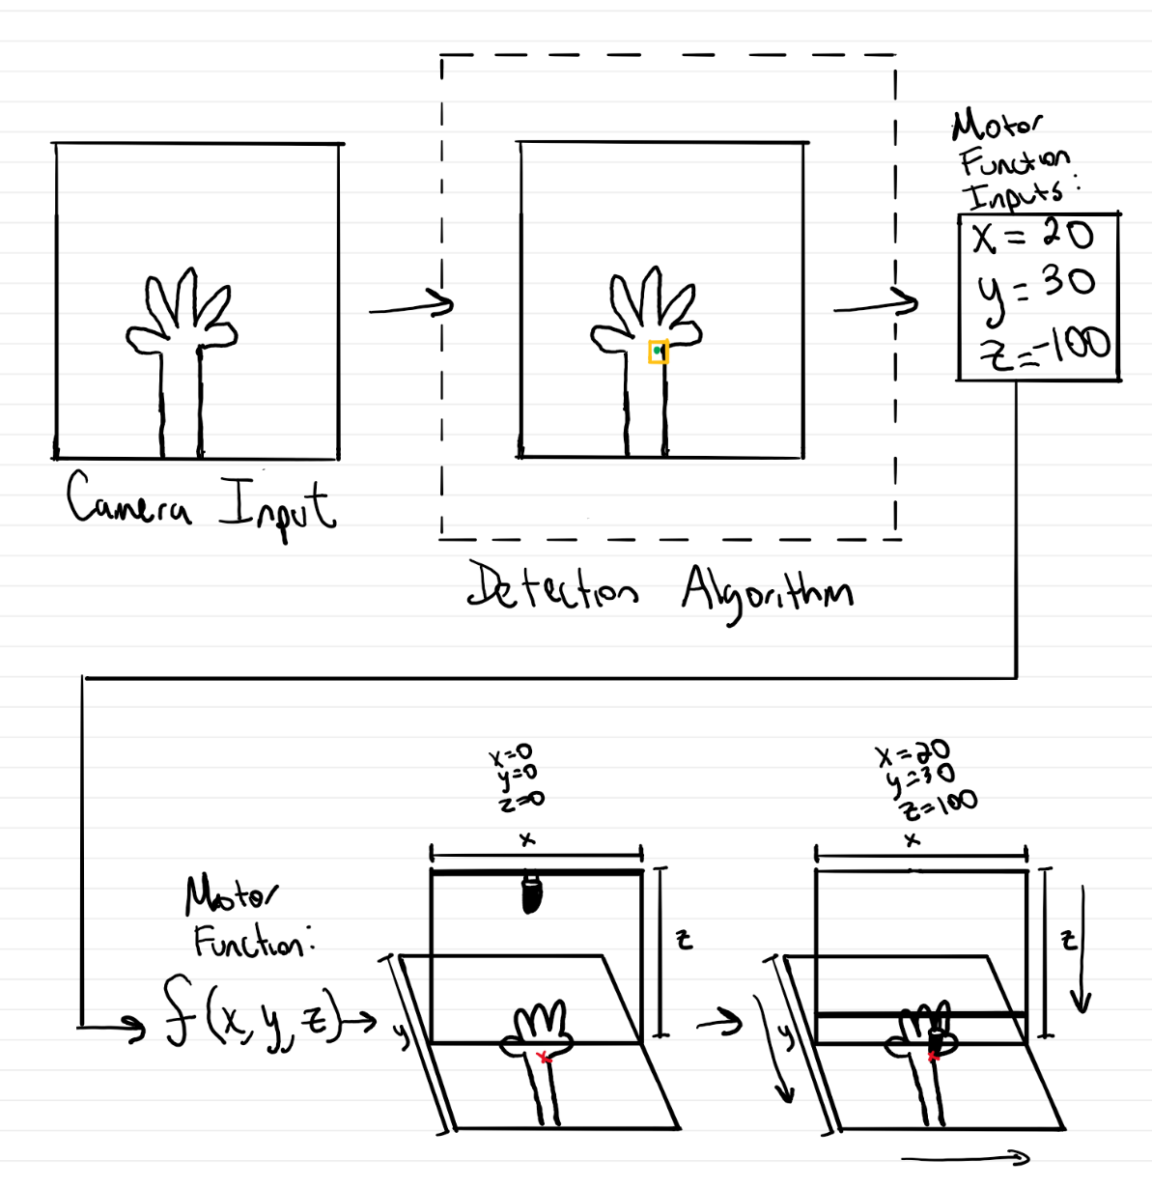
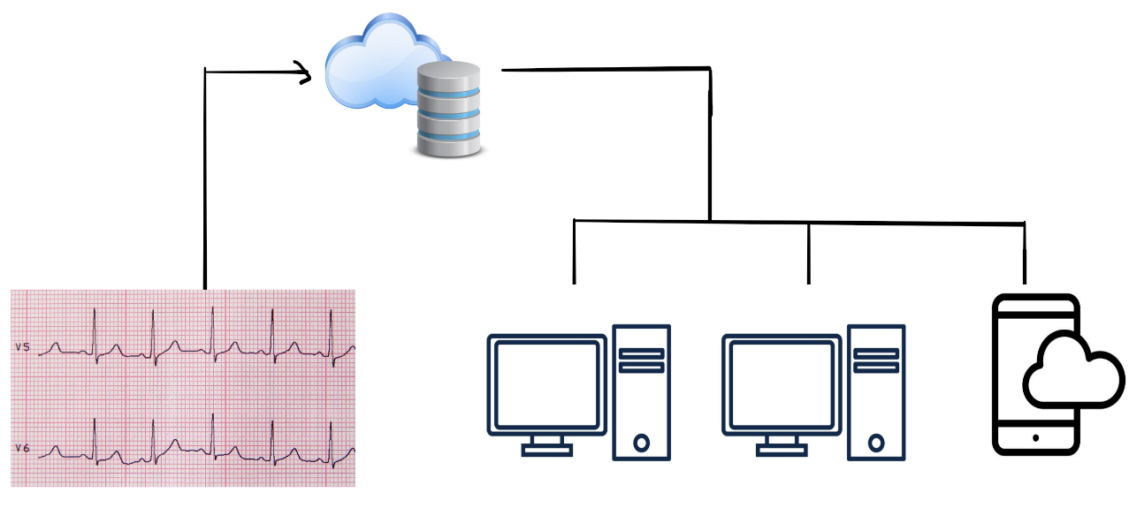
Initial Design and Sketch

Slide 9
Motive

Slide 10





1. Increase Connectivity
Social Networks
Remote Conferencing

Slide 11
2. Ease of Access for Patient
Elderly population in Eastern Taiwan living in remote areas
Proposed tool allows for convenience – making it more accessible for these people to consult a doctor

Slide 12
Implementation

Slide 13
Automated Pulse Sensing Tool
Hardware
Software
X,Y,Z Motors
Camera
Pulse Sensor
Main GUI
Arduino Control
Detection Algorithm
Firebase Configuration

Slide 14
Hardware

Slide 15
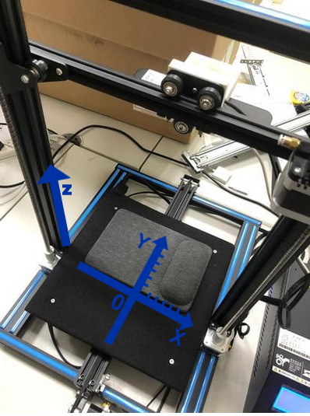
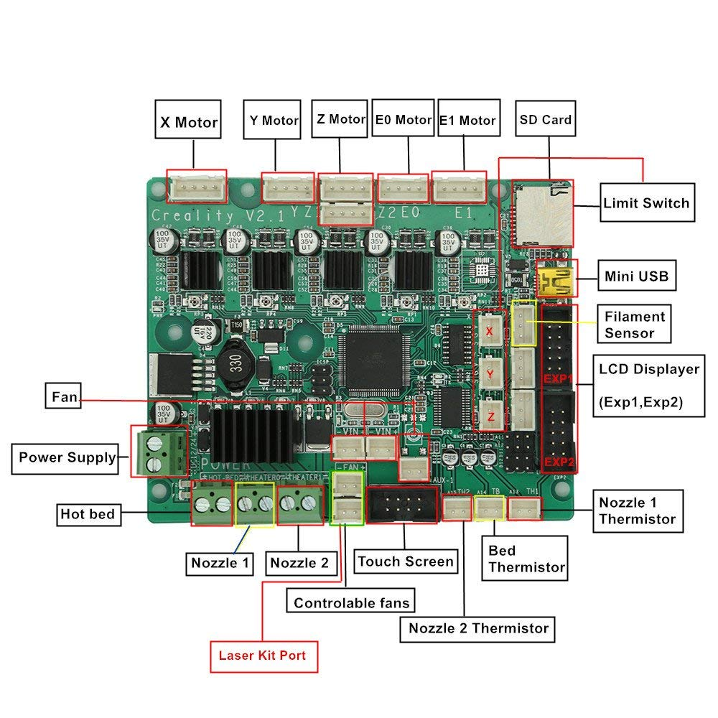
1.) Creality 3D printer
Main Base
X,Y,Z Step Motors & Stop Switches
Controlled By Arduino 2560
motherboard

Slide 16
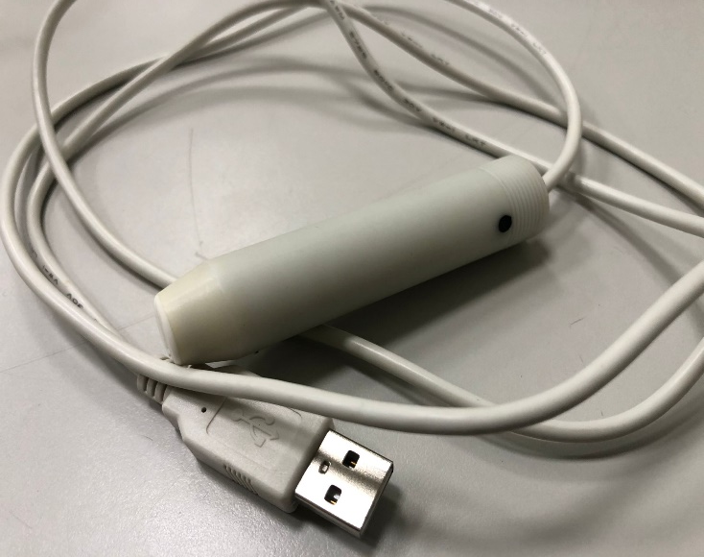
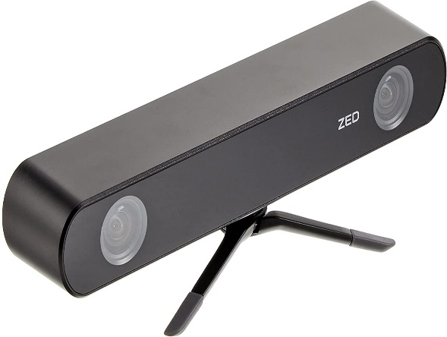
2.) Pulse Sensor and Camera
HK-2019 Cylindrical Pulse Sensor
- 200 Hz - Pulse and Pressure
StereoLabs ZED Dual Camera
- High frame rate and depth
perception.

Slide 17
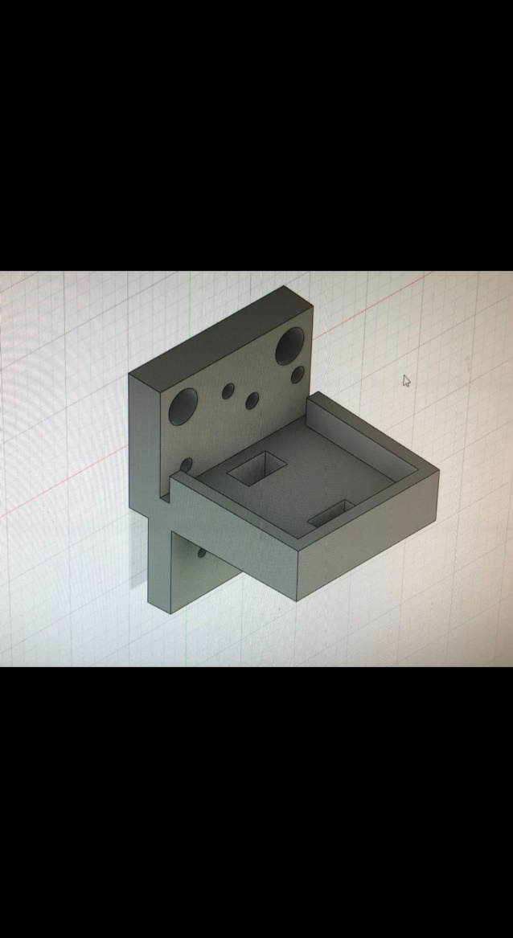
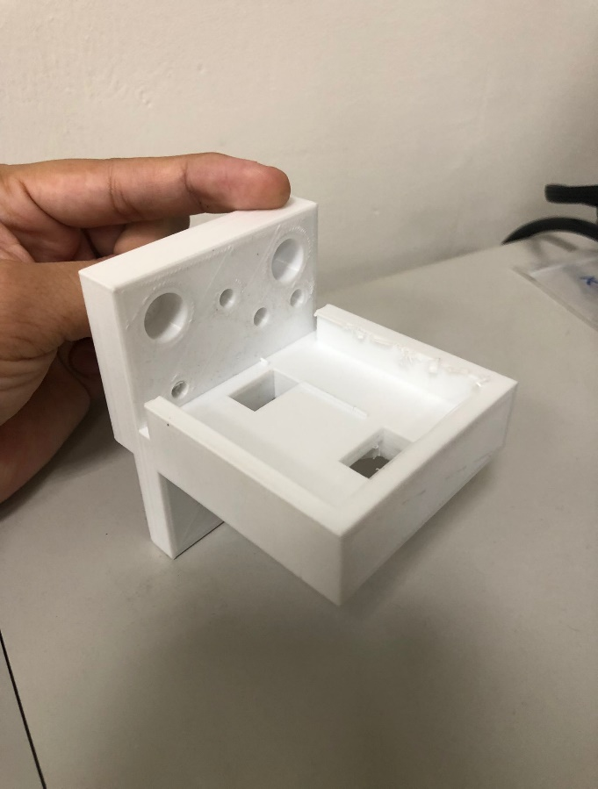
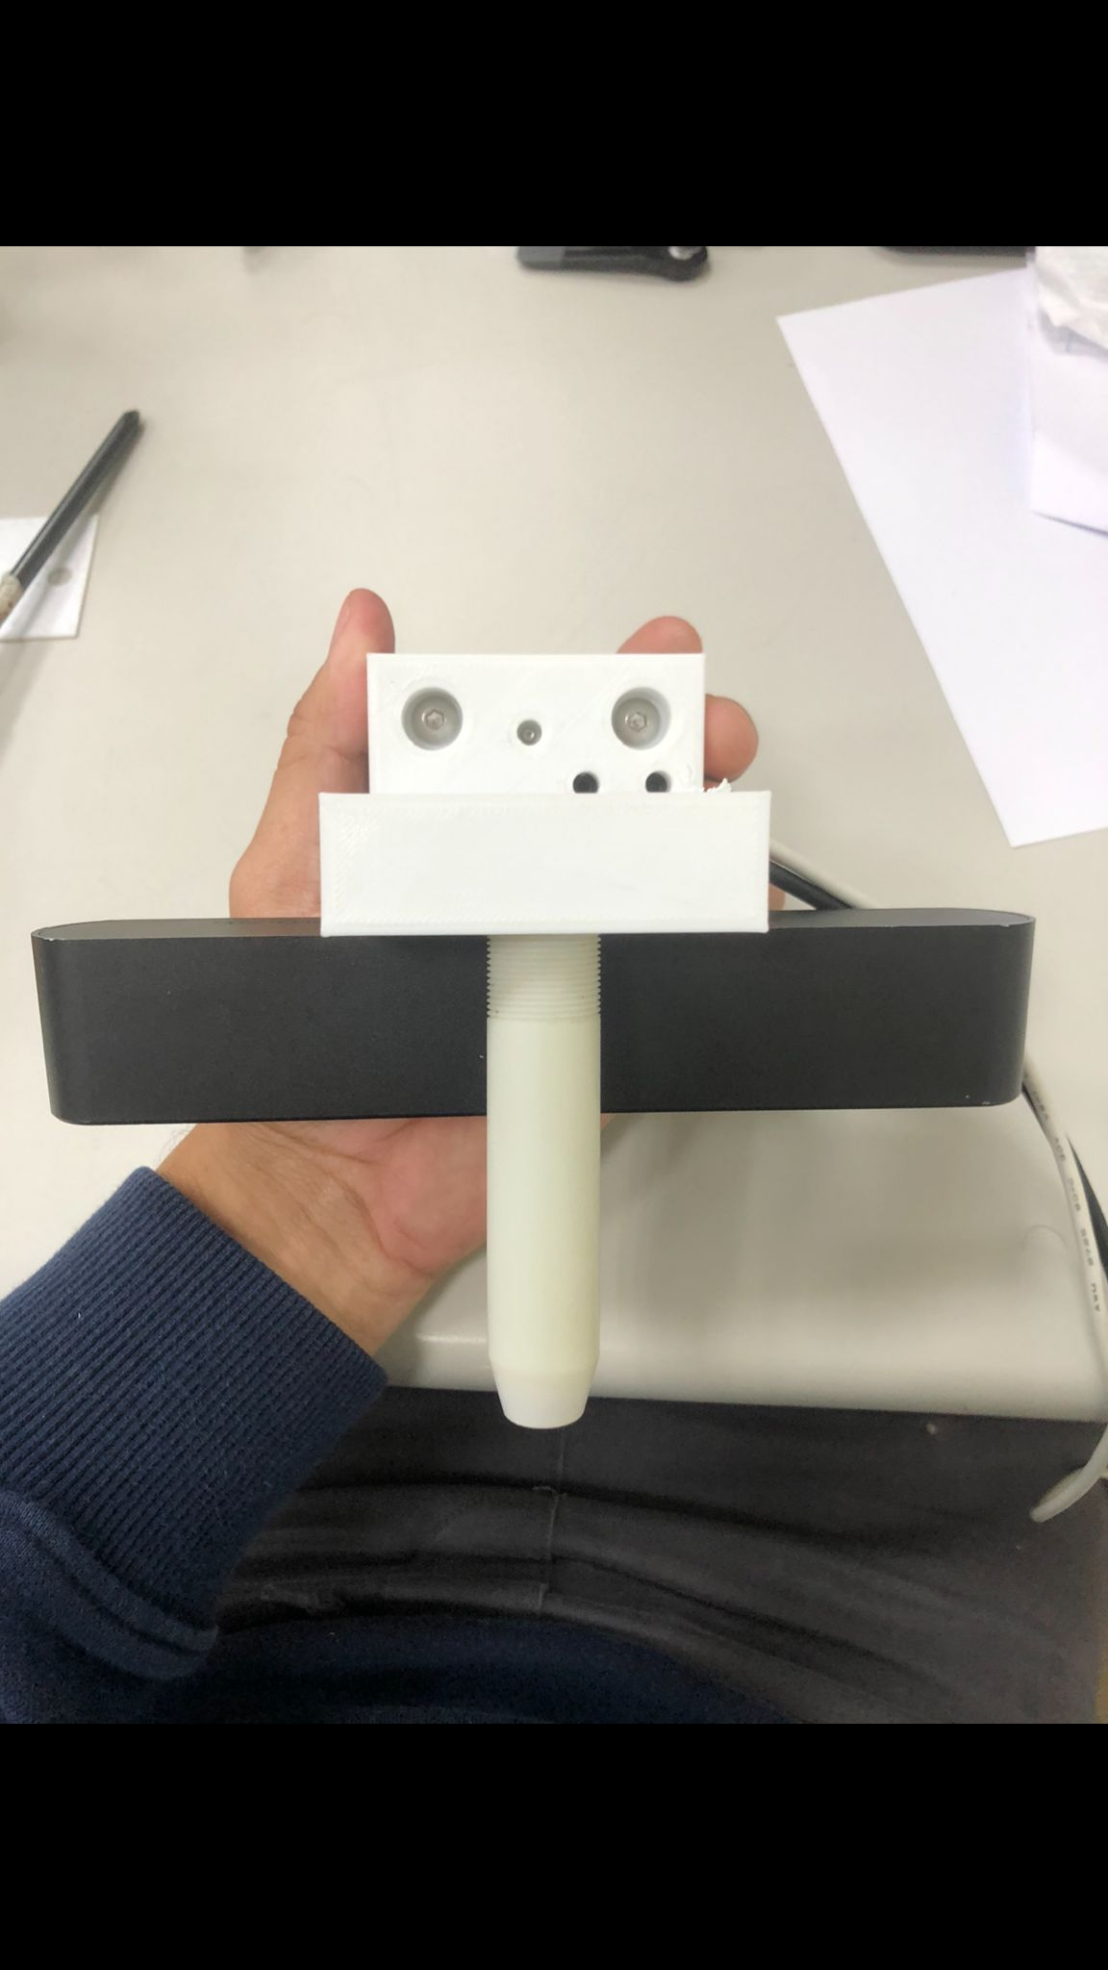
3.) Pulse Sensor/Camera Hold
To mount both Pulse Sensor and Camera, a specially designed 3D-printed piece was needed.

Slide 18

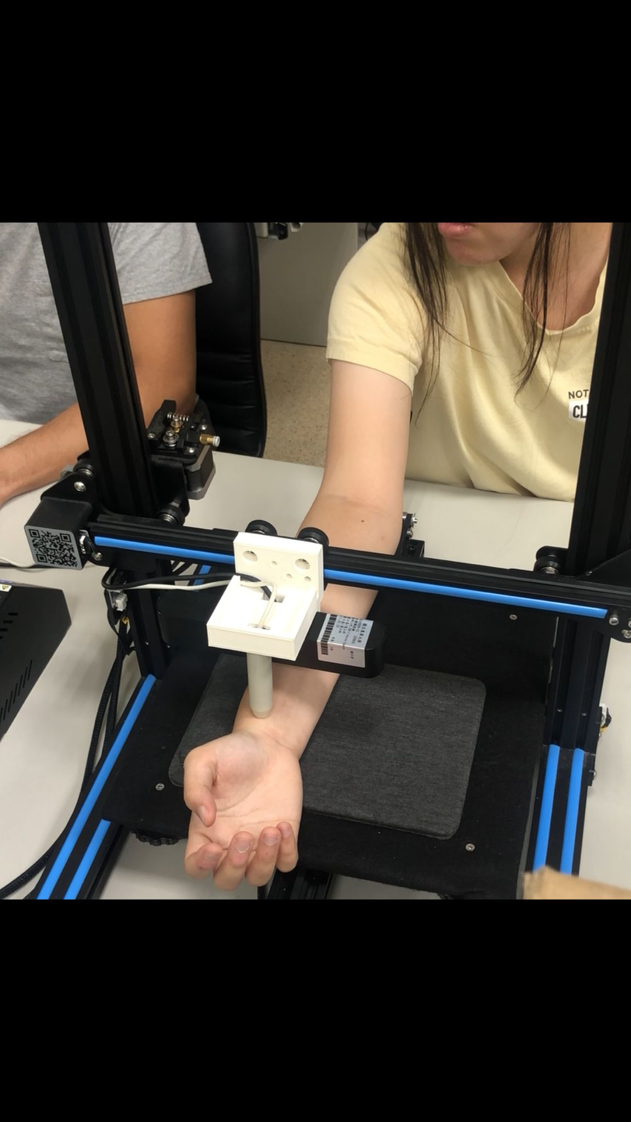
Completed Hardware

Slide 19
Software

Slide 20
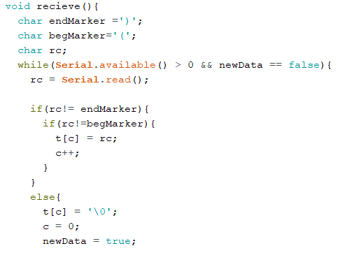
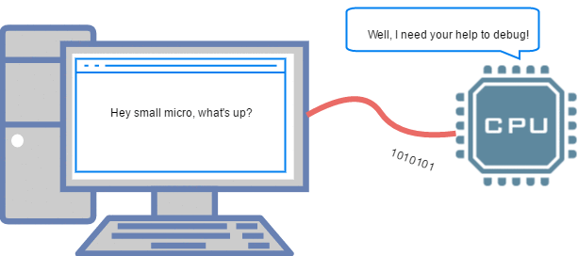
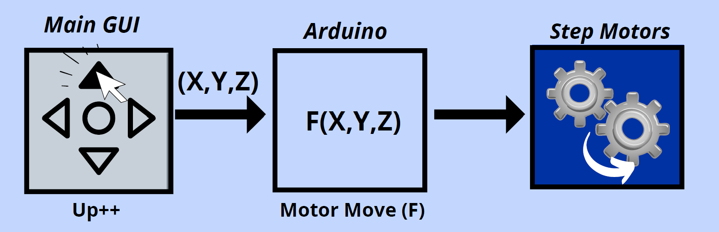
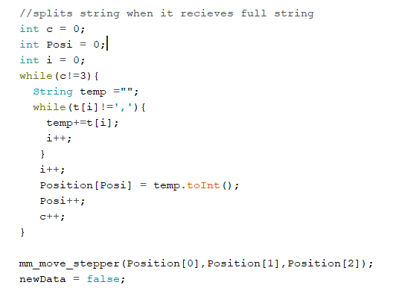
1.) Arduino Control

Slide 21
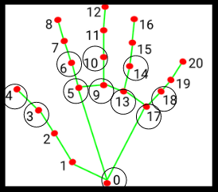
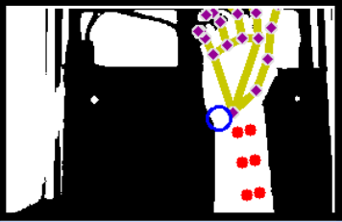
2.) Detection Algorithm
Uses Python package Mediapipe – Hand Landmarks
Developed by ⼨關尺辨 識 group and implemented in my project

Slide 22
3.) Main GUI
Developed with Python using Tkinter GUI package
Main program that doctors and patients will use

Slide 23
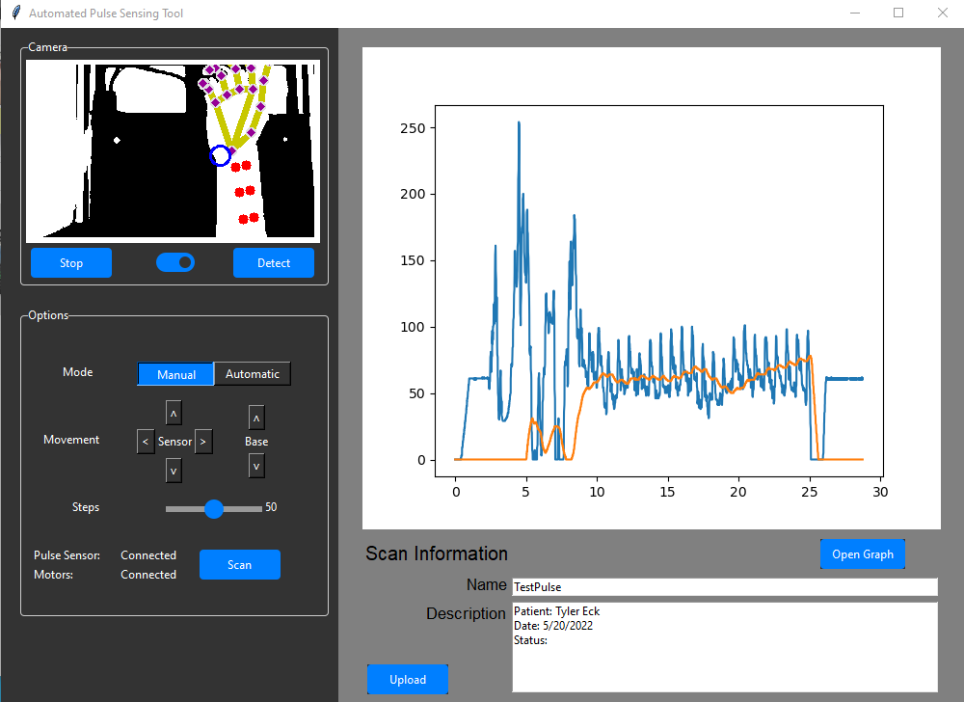

Slide 24
Camera
Live Camera Feed
Detection of Pulse Point
On/Off Camera

Slide 25
Options
Automatic and Manual mode
Movement Arrows for Motors
Motor Step Config.
Connection Data
Scan Button

Slide 26
Graph
Graph Display
Open Graph Button

Slide 27
Information
Enter Information about Patient
Enter Description Information
Upload Button

Slide 28
Program Execution

Slide 29
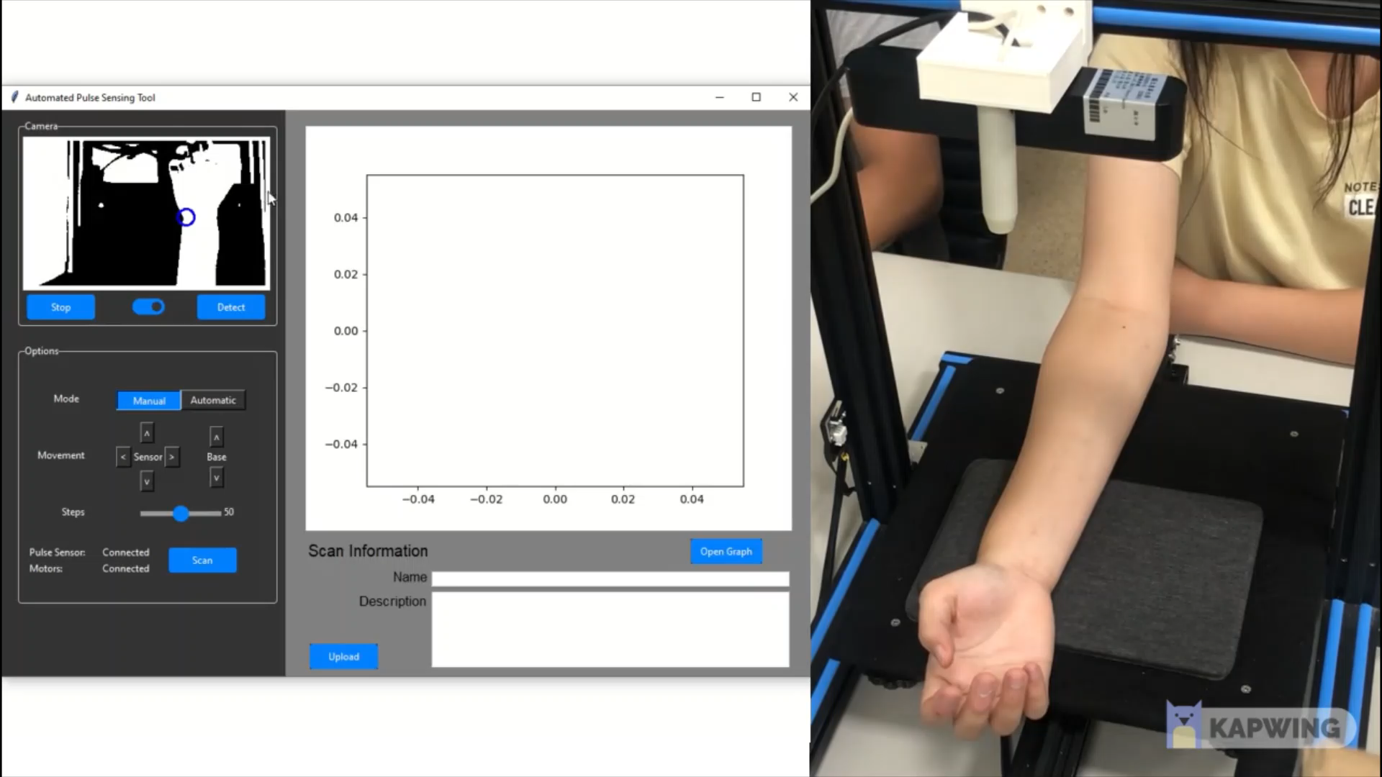
Manual Mode

Slide 30
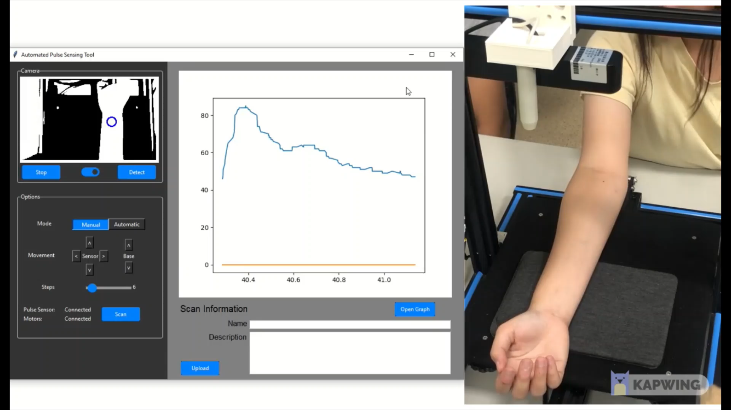
Automatic Mode

Slide 31
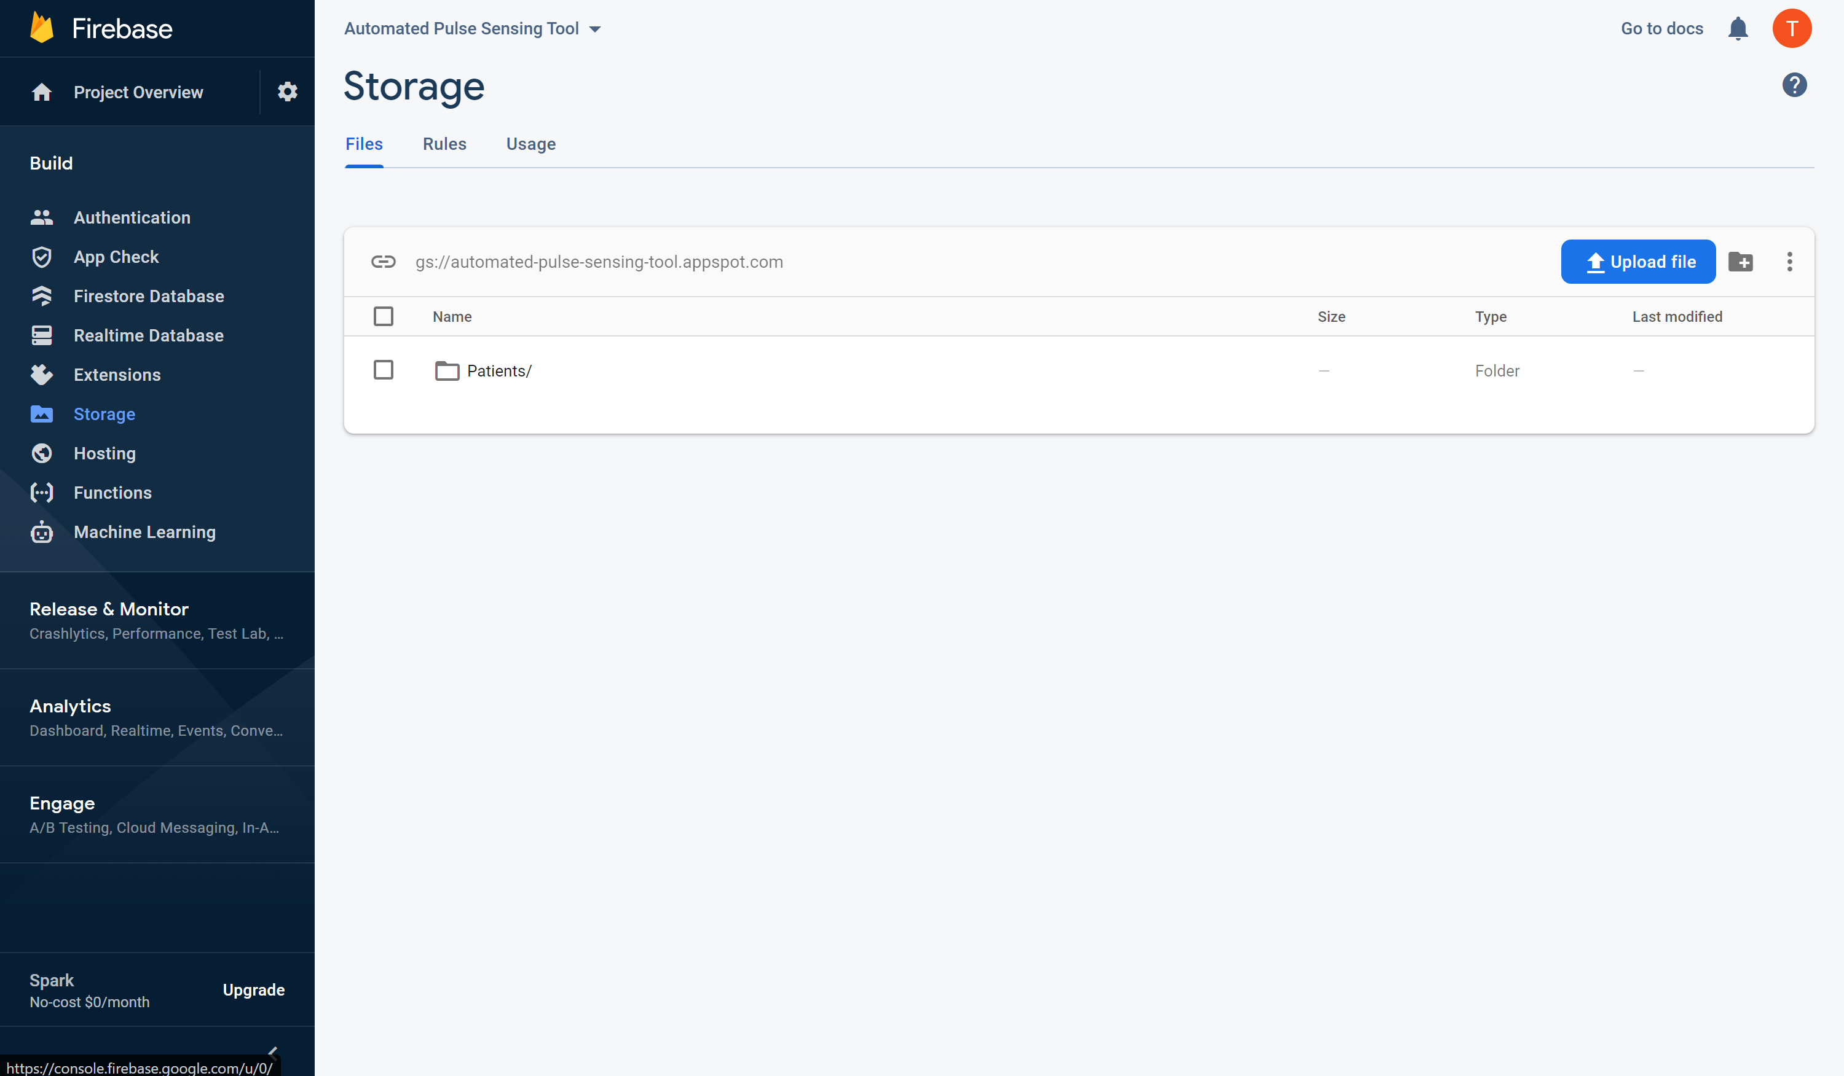
Upload to Firebase

Slide 32
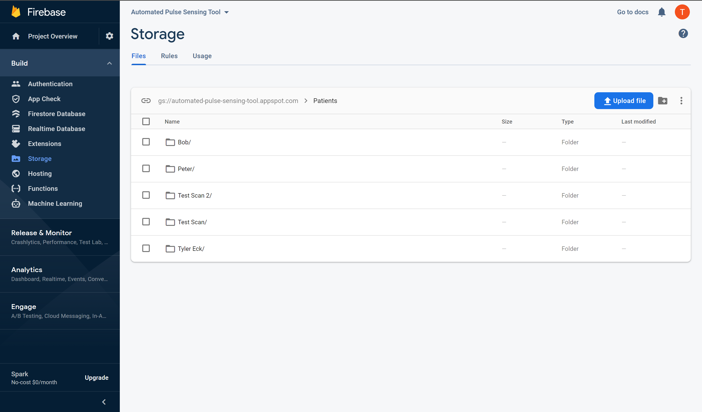
Upload to Firebase

Slide 33
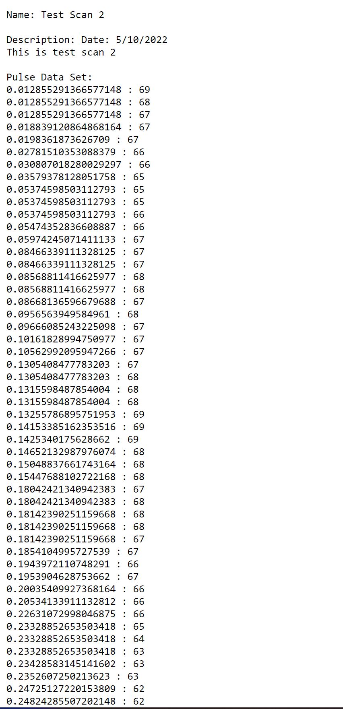
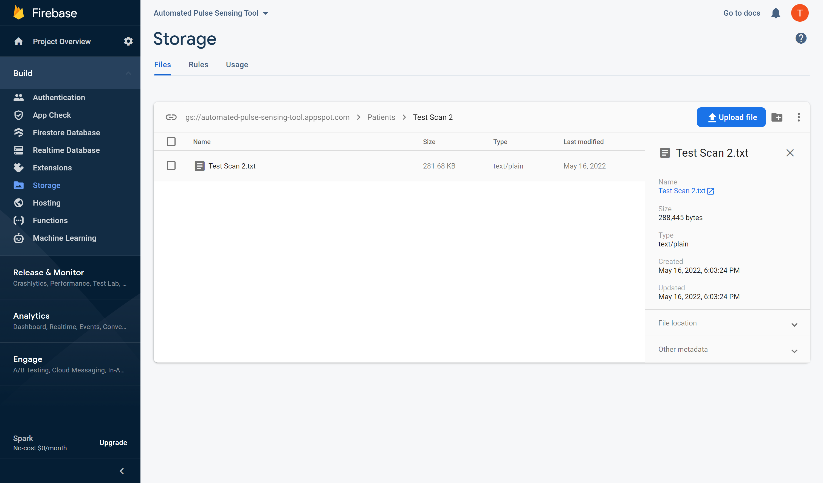
Upload to Firebase

Slide 34
Research Results

Slide 35
Results
“Proof of concept” – not official
Similarities between readings from the Automatic Pulse Sensing Tool and official pulse waveforms

Slide 36
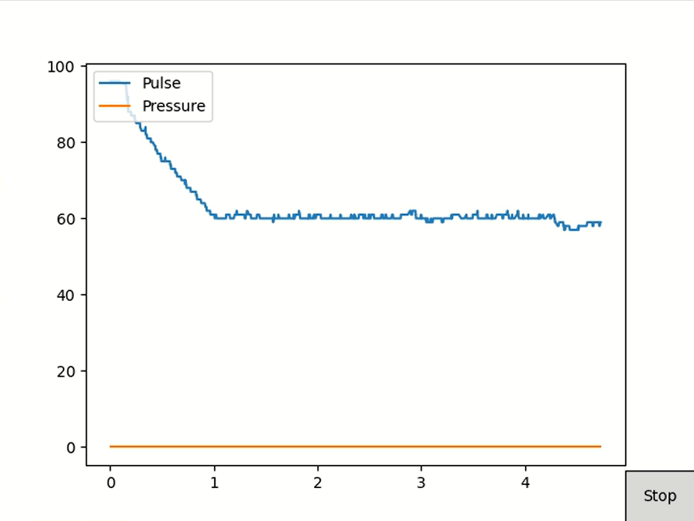
Wrong Z Height Reading

Slide 37
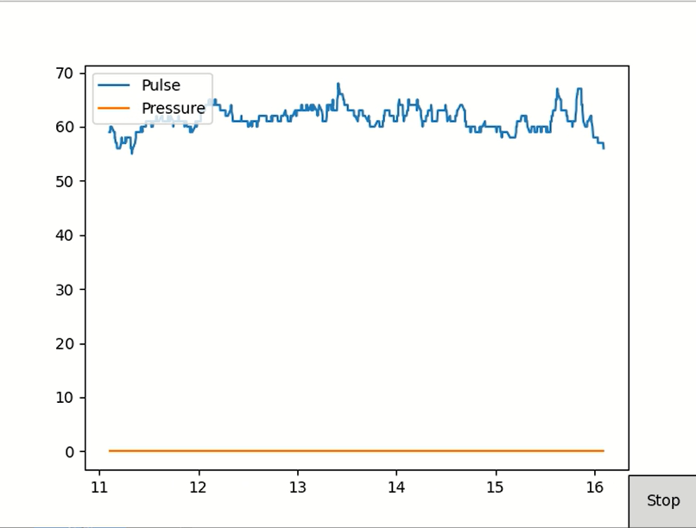
Wrong X,Y Coordinate Reading

Slide 38
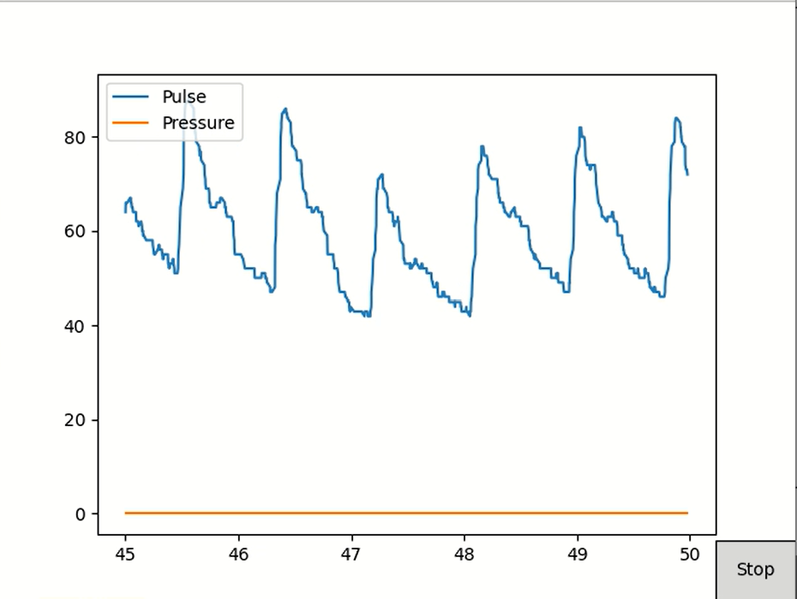
Correct Reading

Slide 39
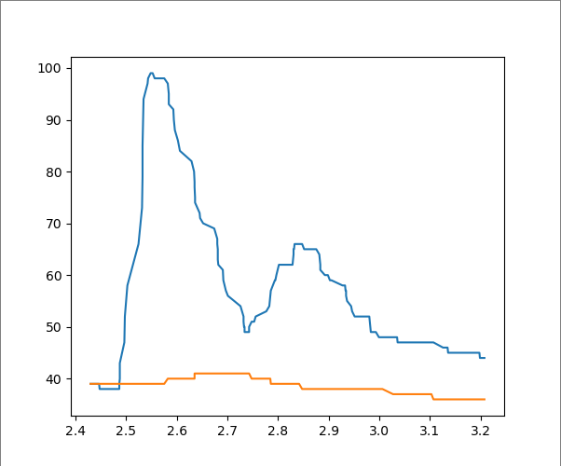
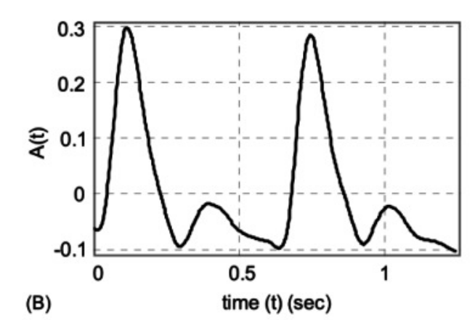
Comparison

Slide 40
Conclusions
Similarities to official pulse waveforms indicate that the software and hardware are properly implemented.

Slide 41
Thank you!
Questions?

